Slide 1

Machine Learning Regressions in O&G
Source Data: Secretaria de Energia de la nacion Argentina

Slide 2

Dealing with large Databases
When we have relational databases with a huge number of features, It is challenging to find relationships among the dataset characteristics
Machine learning regressions algorithms show as possible solution to deal with this issue.

Slide 3

Problem description
Unsupervised Large Relational Data Set
16 features: Well characteristics (Columns)
551 Wells from Vaca Muerta Shale (Records or rows) that at least have 12 months cumulative production
Find relationships among features to predict 12 month Oil production
Machine Learning Regressions Algorithms used: Linear, Polynomial, Huber and Random Forest

Slide 4
Database Features
Lateral Length (m)
Stage Count
Fluid Pumped (bbl)
Max Treatment Pressure (psi)
Horse-Power Treatment (HP)
Proppant Pumped (lb)
Proppant Intensity (lb/ft)
Fluid Intensity (bbl/ft)
Stage Frac Length (m)
Prop / Fluid (lb/bbl)
Max Treatment Rate (bbl/min)
12-month Oil Prod
12-month Gas Prod
12-month Water Prod
X coordinate
Y coordinate
Disclaimer: This is public data. You can add the features that you consider important for your analysis

Slide 5
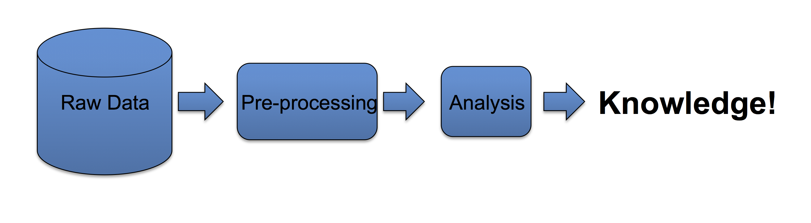
Model Workflow
Data Exploration
Data Filtering
Prepare Training Data for Regression Model
Train Regression Model
Evaluate Regression Model

Slide 6
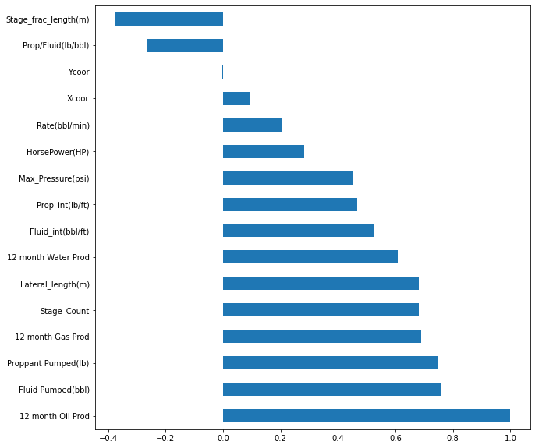
Feature Correlation with Oil Production
We can check here the features’ correlation with the 12-month oil Production.

Slide 7
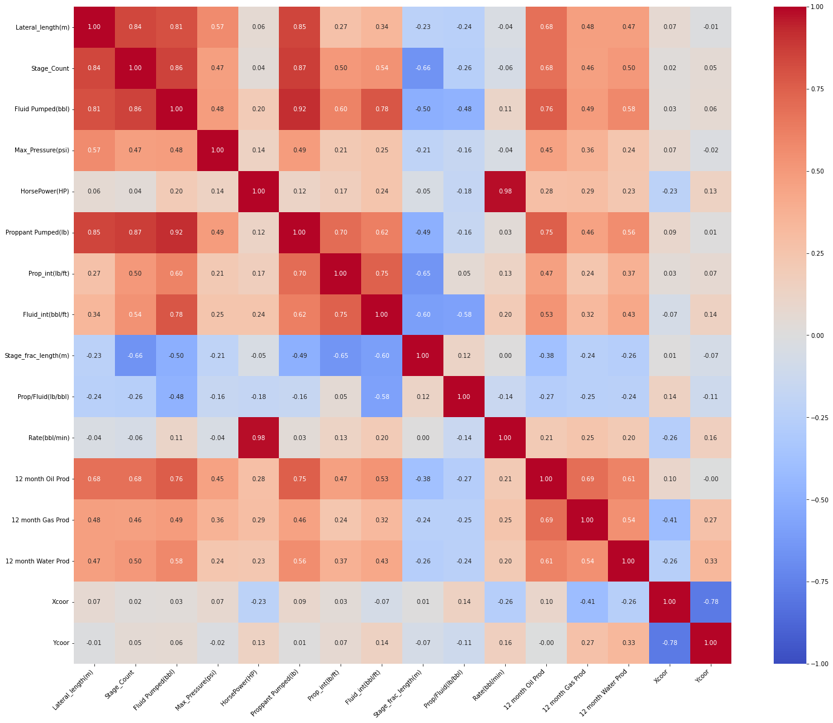
Feature’s Correlation Matrix
Here, we can see how these features are correlated.
We can use the previous plot and this one to do some feature engineering selection

Slide 8
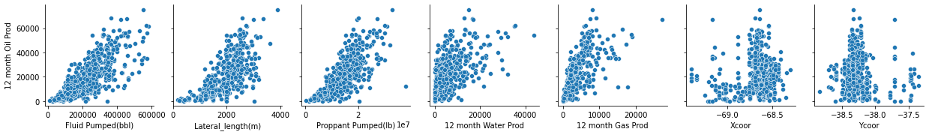
Feature Selection
Highlights:
Features chosen: Fluid Pumped, Lateral Length, Proppant Pumped, 12-month Water Prod, 12-month Gas Prod, X coor, Y coor
These features tend to show a tendency.

Slide 9
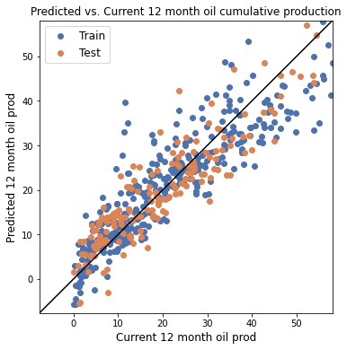
Linear Regression Model Training and Evaluation
Train data:
the r2 score is 0.813, the MAE is 5023.804, the MSE is 45811451.900 and the RMSE is 6768.416
Test data:
the r2 score is 0.823, the MAE is 4628.585, the MSE is 32257743.688 and the RMSE is 5679.590

Slide 10
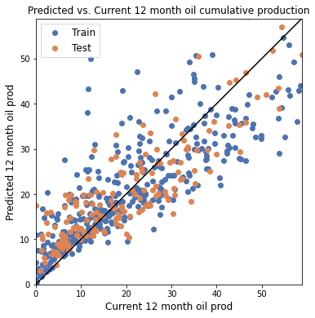
Huber Regression Model Training and Evaluation
Train data:
the r2 score is 0.700, the MAE is 6244.135, the MSE is 73556978.726 and the RMSE is 8576.537
Test data:
the r2 score is 0.727, the MAE is 5636.955, the MSE is 49787118.469 and the RMSE is 7055.999

Slide 11
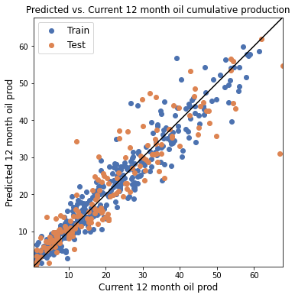
Quadratic Regression Model Training and Evaluation
Train data:
the r2 score is 0.925, the MAE is 2998.581, the MSE is 16916330.198 and the RMSE is 4112.947
Test data:
the r2 score is 0.843, the MAE is 4060.897, the MSE is 36016862.178 and the RMSE is 6001.405

Slide 12
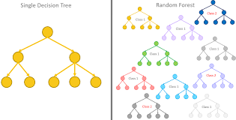
Random Forests
Popular and widely used Model
Combination of random decision trees
The random approach takes advantage of stochastic discrimination and the law of the great numbers
Algorithm is called IC3
Random Forests can handle Classification and Regression problems
More info about RF: https://mlu-explain.github.io/random-forest/

Slide 13
Random Forests Pros/Cons
PROS
Precise and efficient classifier for large datasets
Capable of large features handling
Weighted feature approach
Empirical model to detect feature interaction
CONS
If dataset is noisy, RF tend to overfitting
RF Classification/Regression is not easy to understand as Decision Tree Classification/Regression
If the dataset have high level categorical data, RF tend to focus on these variables rather than others
If feature correlation is similar, RF tend to focus on small groups rather than larger ones.

Slide 14
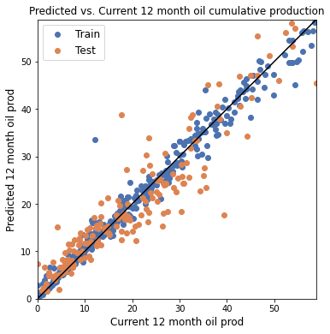
Random Forest Regression Training and Evaluation
Train data:
the r2 score is 0.980, the MAE is 1412.988, the MSE is 4960886.717 and the RMSE is 2227.305
Test data:
the r2 score is 0.863, the MAE is 3584.758, the MSE is 25031817.926 and the RMSE is 5003.181

Slide 15
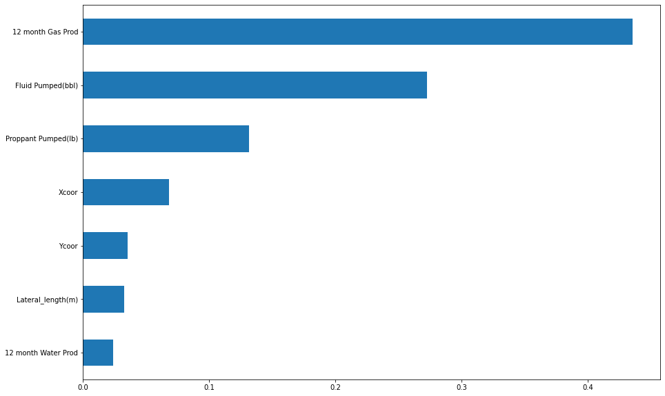
Random Forest Model Feature Importance's

Slide 16
Model’s Comparative Results Table
 | Model | R2 | MAE | MSE | RMSE
0 | RF Train | 0.979734 | 1412.988117 | 4.960887e+06 | 2227.304810
1 | RF Test | 0.862536 | 3584.757973 | 2.503182e+07 | 5003.180781
2 | LR Train | 0.812857 | 5023.804437 | 4.581145e+07 | 6768.415760
3 | LR Test | 0.822854 | 4628.584951 | 3.225774e+07 | 5679.590099
4 | HR Train | 0.699515 | 6244.134828 | 7.355698e+07 | 8576.536523
5 | HR Test | 0.726590 | 5636.954920 | 4.978712e+07 | 7055.998758
6 | PR Train | 0.924606 | 2998.580545 | 1.691633e+07 | 4112.946656
7 | PR Test | 0.843464 | 4060.896738 | 3.601686e+07 | 6001.405017

Slide 17
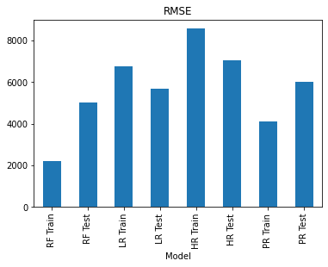
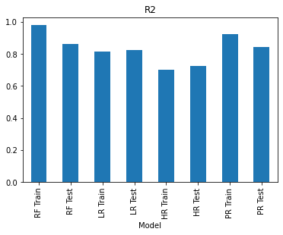
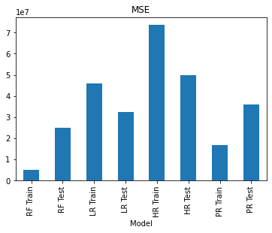
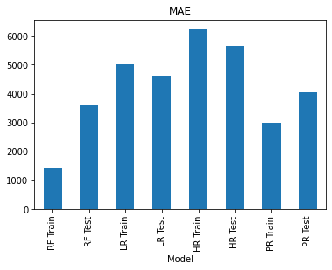
Model’s Comparative Results Plots

Slide 18

Recommendations
Train a Decision Tree Regression Model for a better description of our problem.
Get a Categorical or binary feature that supervises our database. For example, if the well has met any economical or financial outcome (Yes-No)
Try another Unsupervised ML technique for new insights.
Errors are composed by bias, variance and noise. We can’t do much to reduce noise, but we can establish a trade-off between bias and variance to minimize the error.
If the model is too simple, it ignores useful information, and the bias drives the error. If it is too complex, it memorizes non general patterns and variance governs the error. Just a sweet spot, not to simple neither too complex.
Add more features to the model to see its impact like for example Parent-Child Interactions, Geology and Reservoir inputs.

